Slide 1
Implementing Forms

Slide 2
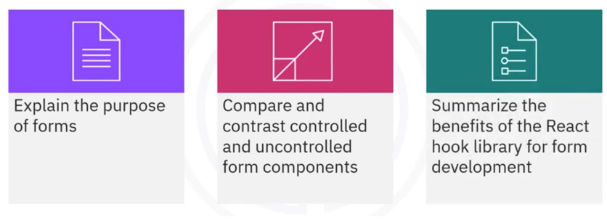
What you will learn

Slide 3
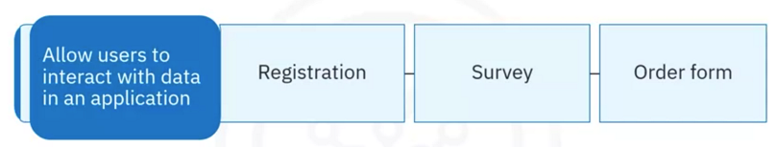
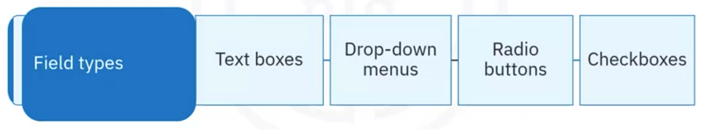
Form introduction

Slide 4

Handling forms
Submission
logic
Data
validation
Input

Slide 5
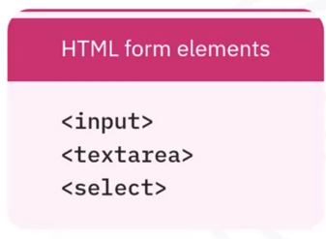
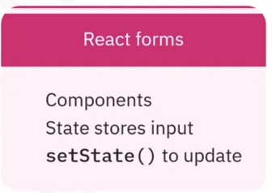
HTML versus React

Slide 6

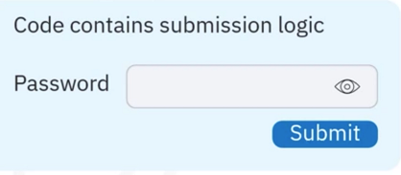
Submission

Slide 7
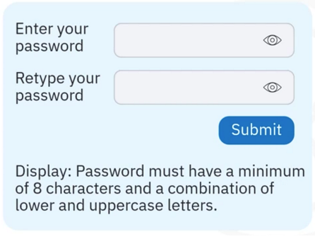
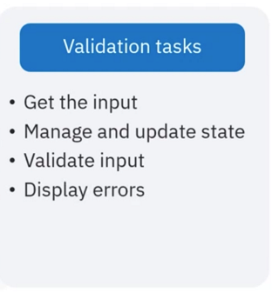
Validation

Slide 8
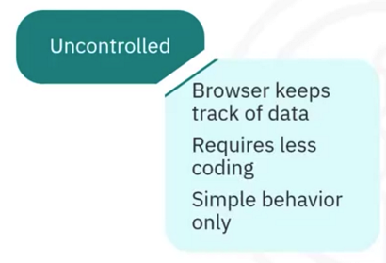
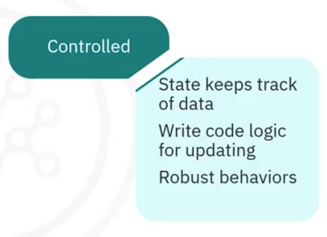
Uncontrolled versus controlled

Slide 9
Uncontrolled components
Browser hand Les form elements
Data stored by the DOM
Input updates automatically
Requires “ref” functions
to get form in put
No event handlers are needed
for state changes

Slide 10
Controlled components
You write Logic to
handle state changes
The state stores the
data
onChange events
setState() for input
Event handlers

Slide 11
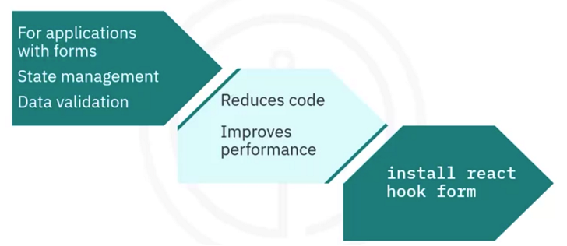
React hook form library

Slide 12
Recap
In this video, you Learned that:
• Forms provide a way for users to interact with data in a web application
• Forms usually require input fields, submission Logic, and validation rules
to handle user interactions
• The browser keeps track of data and the state of elements with the DOM
in uncontrolled components
• Controlled components require you to explicitly manage the UI input data
with the component’s state
• The React hook form Library optimizes performance by reducing the
number of times a component renders

